Slide 1
DIGITAL BANK DEMO APPLICATION
NAMES EMPLOYEE_ID
RISHIKESH X 2576444
VAIBHAV KUMAR 2575699
PRUTHVISHREE S K 2576992
ASHUTOSH JHA 2575882
M NAVEEN KUMAR 2575839
BANDARU SANDHYA RANI 2575542
MUKUL PARMAR 2576094
BONDILI SHRIYA SINGH THAKUR 2577118
KASANI APARNA 2576331
~GROUP II

Slide 2
CONTENT
INTRODUCTION
SCENARIOS USED
TECHNOLOGIES USED
SCREENSHOTS

Slide 3

OBJECTIVE
Introducing you to a comprehensive solution that aims to develop and provide the user with different transaction options for Digital Banking . Our project focuses on automating the end-to-end testing application utilizing Selenium WebDriver, TestNG and Cucumber. We have meticulously crafted test.
.

Slide 4

SCENARIOS
We implemented the functionalities of “Online Banking Application” are main purpose of a test scenario is used to check the entire performance from end-to- end point of view.
Functionalities:
Sign Up
Sign In
Deposit into Account
Withdraw from Account
Transfer Between Account
Direct payment to visa
Search by TRN no on View Checking Account
Search by TRN no on View Saving Account

Slide 5
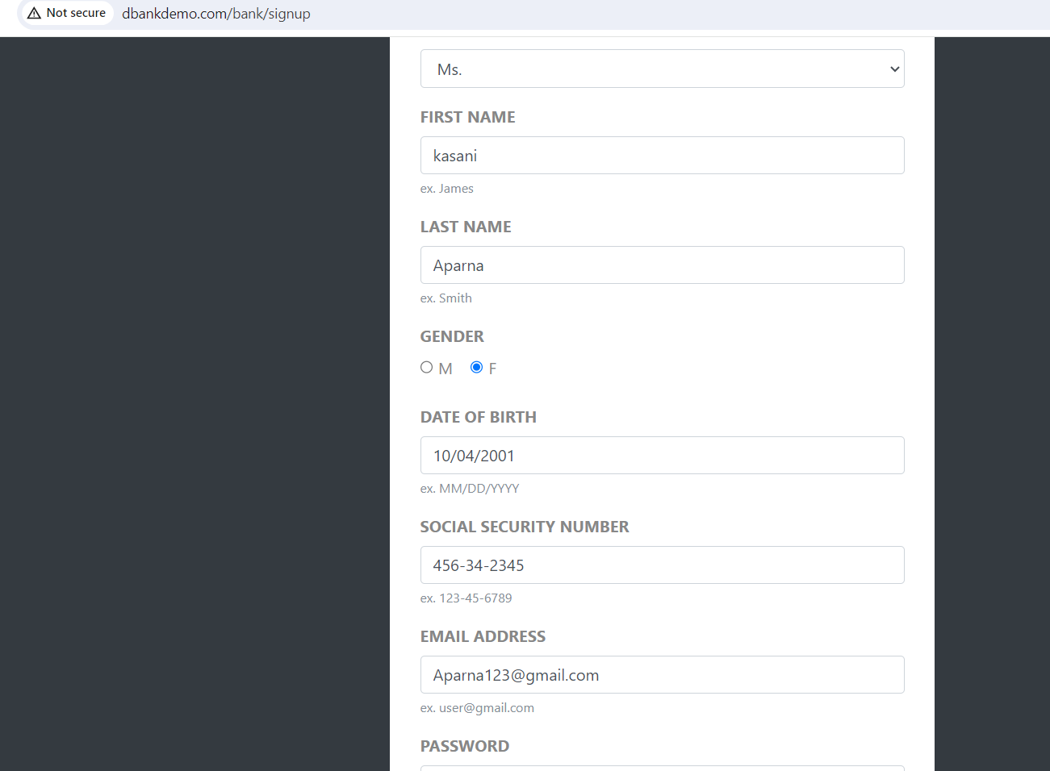
SIGN UP FUNCTIONALITY

Slide 6
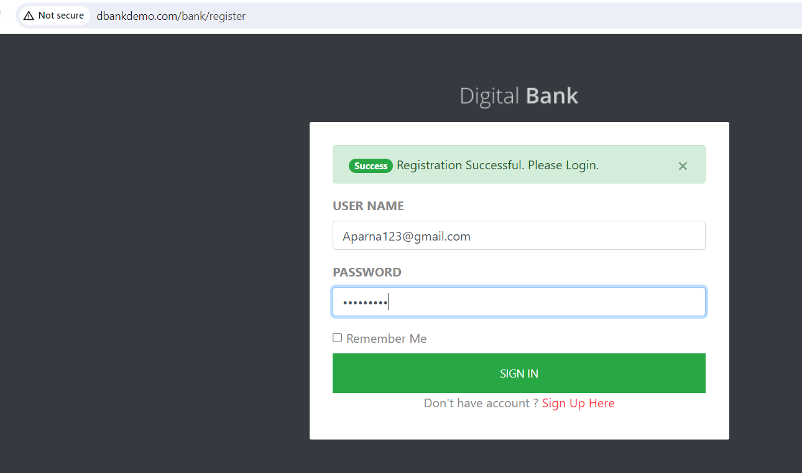
SIGN IN Functionality

Slide 7
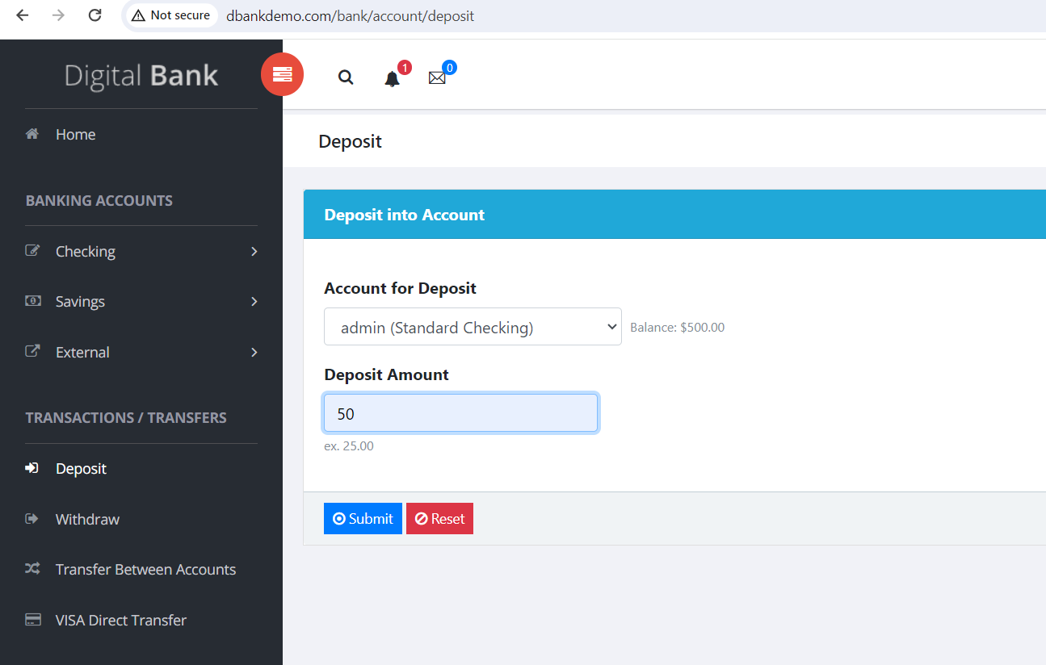
DEPOSIT INTO ACCOUNT FUNCTIONALITY

Slide 8
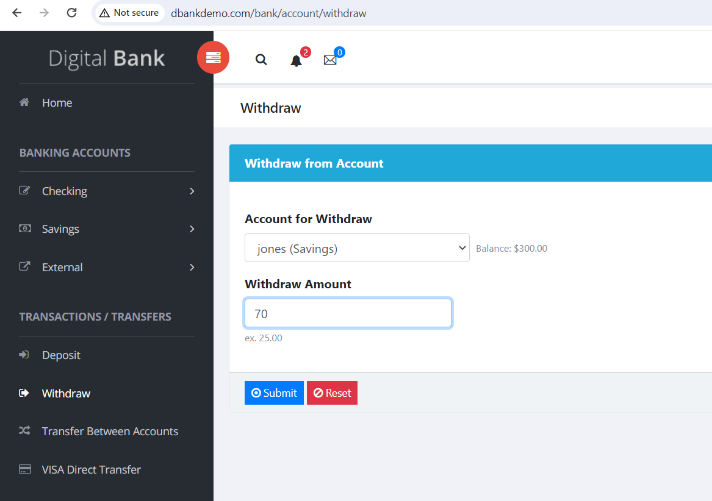
WITHDRAW FROM ACCOUNT FUNCTIONALITY

Slide 9
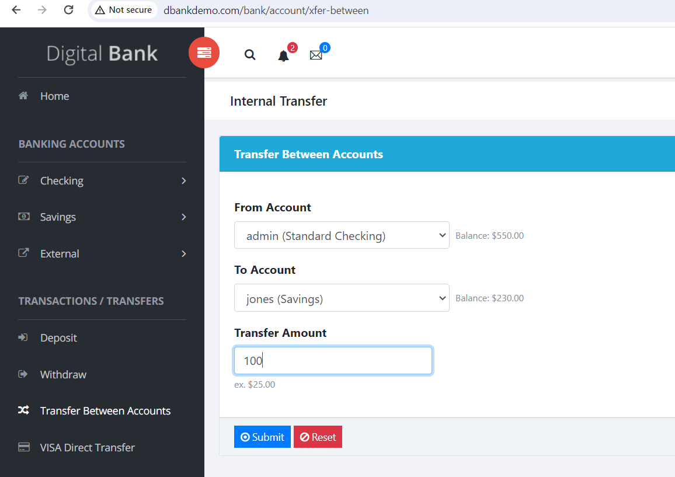
TRANSFER BETWEEN ACCOUNT FUNCTIONALITY

Slide 10
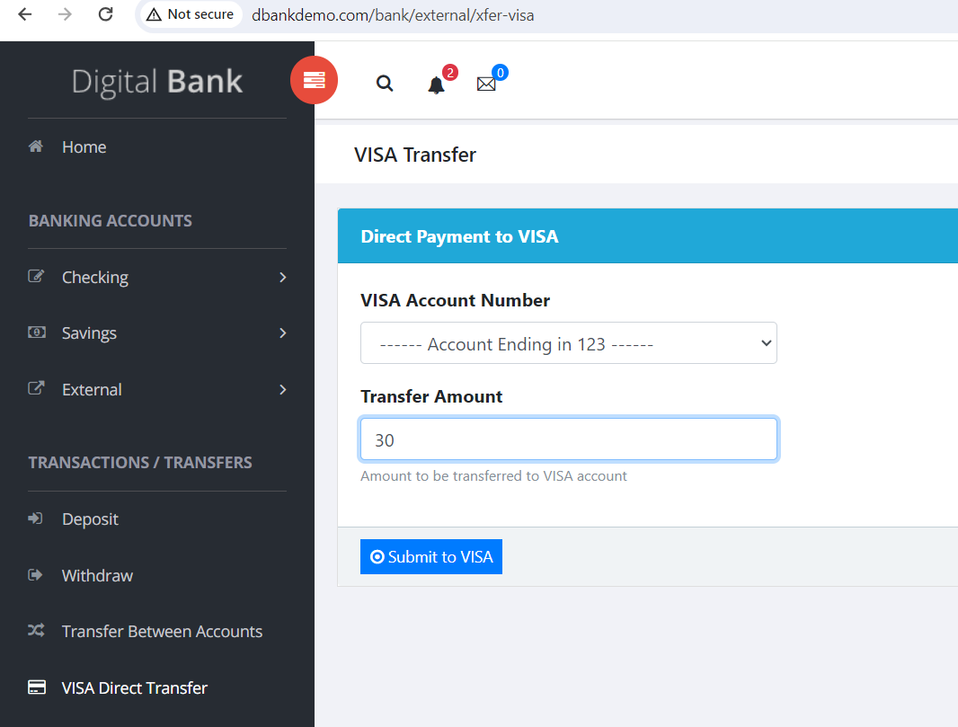
DIRECT PAYMENT INTO VISA

Slide 11
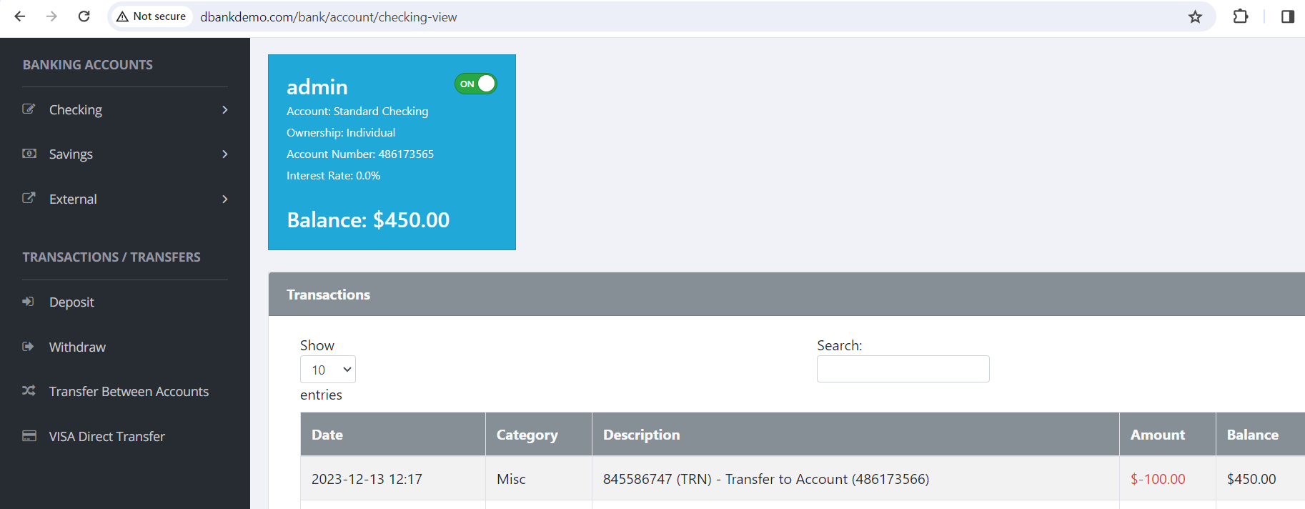
TRN NUMBER - ON VIEW CHECKING ACCOUNT

Slide 12
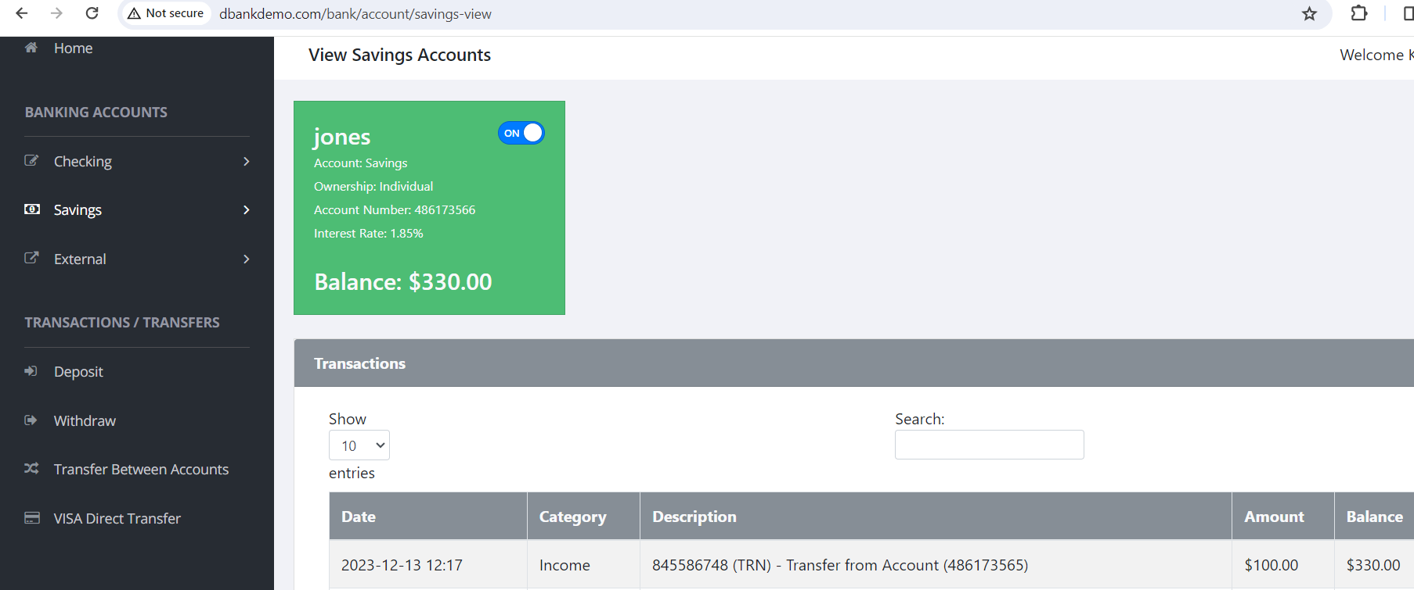
TRN NUMBER - ON VIEW SAVING ACCOUNT

Slide 13

TECHNOLOGIES USED
Selenium WebDriver
TestNG – Listeners, Screenshots, Assertions, Data Provider
Cucumber-Java
Log4j
Jira

Slide 14
SELENIUM WEBDRIVER
Selenium WebDriver tool is used to automate web application to verify that it works as expected.
It support many browser such as Firefox, Chrome, and Safari. However, using the Selenium WebDriver, we can automate testing for web applications only.
WebDriver Methods : WebDriver provides a set of methods to interact with web elements and control browser behavior. Some common WebDriver methods include:
get(String Url)
findElement(By locator)
@findBy--pagefactory
click()
sendKeys()
getText()

Slide 15
SELENIUM WEBDRIVER
LOCATORS:
Locators are used to identify and locate the web elements on a web page. Selenium WebDriver supports various locator strategies.
Types of Locators:
ID
Name
Class Name
Tag Name
Xpath
CSS
Selector

Slide 16
TESTNG LISTENERS
TestNG provides the @Listeners annotation which listens to every event that occurs in a selenium code. Listeners are activated either before the test or after the test case. It is an interface that modifies the TestNG behaviour.
There are many types of listeners which allows you to change the TestNG’s behaviour.
Below are the few TestNG listeners :
IExecutionListener,
ISuiteListener,
ITestListener

Slide 17
LISTENERS
Listeners are implemented by the ITestListener interface. An ITestListener interface has the following methods.
onTestStart()
onTestSuccess()
onTestFailure()
onTestSkipped()
onTestFailedButWithinSuccessPercentage()
onStart()
onFinish()

Slide 18
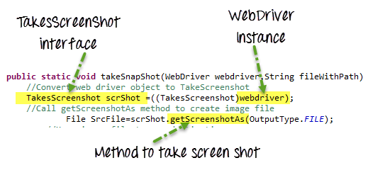
SCREENSHOTS IN SELENIUM
A Screenshot in Selenium WebDriver is used for bug Analysis
Selenium WebDriver can automatically takes screenshots during the execution. But if users need to capture a screenshot on their own, they need to use the TakeScrenshot method which notifies the WebDriver to take the screenshot and store it in Selenium.

Slide 19
SCREENSHOT’S IN SELENIUM
Screenshot for Test Failure:
If a test fails, the ability to take screenshot in Selenium is especially helpful in understanding what went wrong. An easy way to do this would be to use TestNG annotations.
Here are the steps to capture a screenshot in Selenium in this case:
Create a class. Implement TestNG ‘ITestListener‘.
Call the method ‘onTestFailure’.
Take screenshot in Selenium is a great way to capture important data quickly and easily. Using the WebDriver method, you can take screenshot in Selenium of any element that is visible on your page.

Slide 20
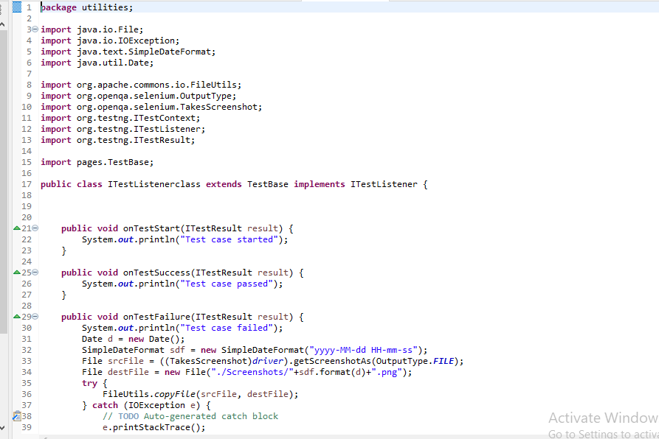
Code Snippet for Screenshot Taking

Slide 21
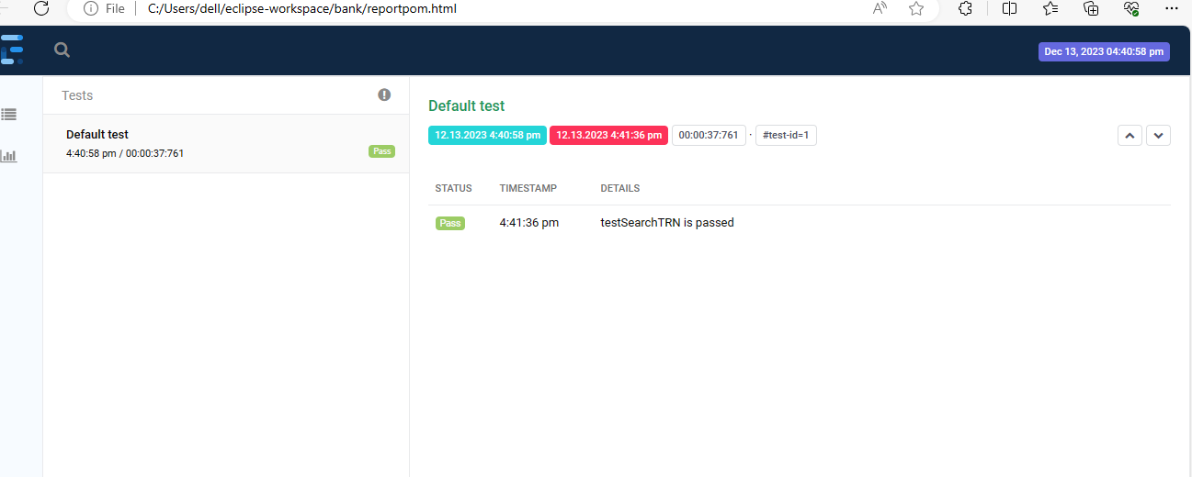

Slide 22
ASSERTIONS
Assertions is an Expression which verifies Actual Test outcome with Expected Test outcome .
Based on Outcome Validation we can say Whether the test is Passed or Failed.
Asserts in Selenium validates the automated test cases, that which helps the testers to understand whether the tests have passed or failed

Slide 23
ASSERTIONS METHODS
assertEquals() : Evaluates whether the expected and actual outputs of the test case are equal.
assertNotEquals() : This method does the opposite of the assertEquals() method.
assertTrue() : This Assertion verifies the Boolean value returned by the condition. If the Boolean value is true, then the assertion passes the test case .
assertFalse(): This method is opposite to assertTrue().
assertNull(): This method verifies if the expected output is null and if not, then the value returned is false.
assertNotNull(): This method works opposite to the assertNull() method, and the assertion condition is met when the method validates the expected output to be not null.
assertSame(): This method is used to compare the objects and not the content. It returns true if the expected value is the same as the actual value else returns false.
assertNotSame(): This Method is Opposite to assertSame().

Slide 24
TYPES OF ASSERTION
Types of Assertions :
Hard Assertions
Soft Assertions
Hard Assertions :This Assertions throws out the failure/Exception immediately. When test fails , it stops execution there itself the rest of statements won't execute .
Syntax : Assert.assertEquals(actualTitle,expectedTitle,”Custom Message”);

Slide 25
TYPES OF ASSERTIONS
Soft Assertion :This type of assertions do not throw an exception immediately when an assertion fails and continues with the next step of statement execution.
SoftAssert softAssert = new SoftAssert(); --- Creating a Class SoftAssert with an Object.
SoftAssert.assertAll(); ---- This is used to catch Exception at end of test case Execution.
Syntax : SoftAssert.assertEquals(actualTitle,expectedTitle);

Slide 26
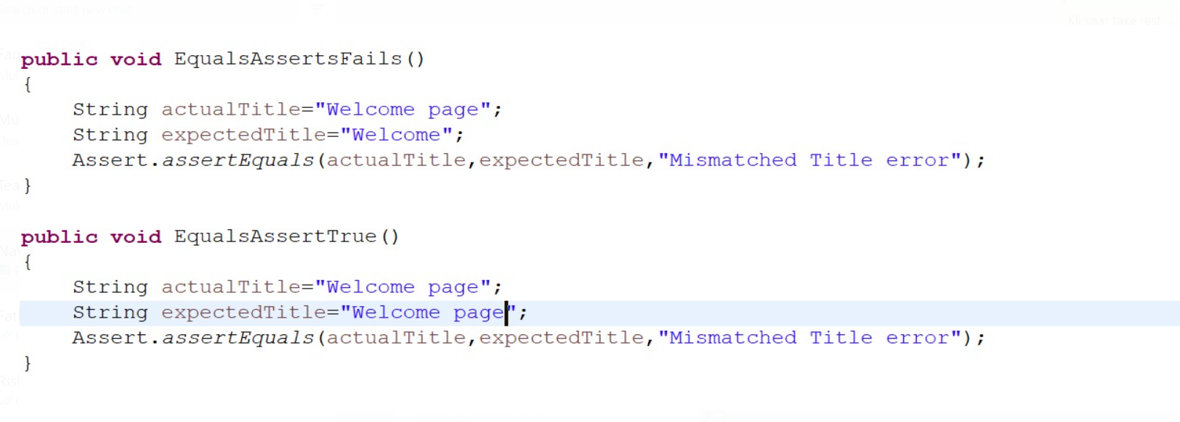
Code Snippet of Assertion Equals / NotEquals

Slide 27
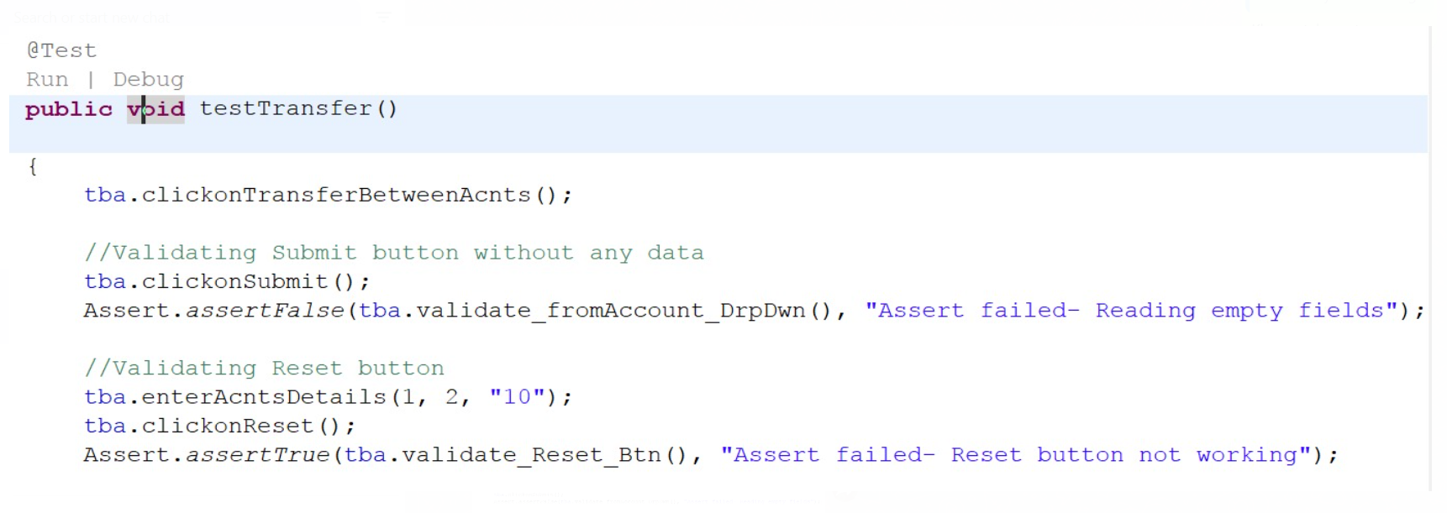
Code Snippet of Assertion TRUE / FALSE

Slide 28
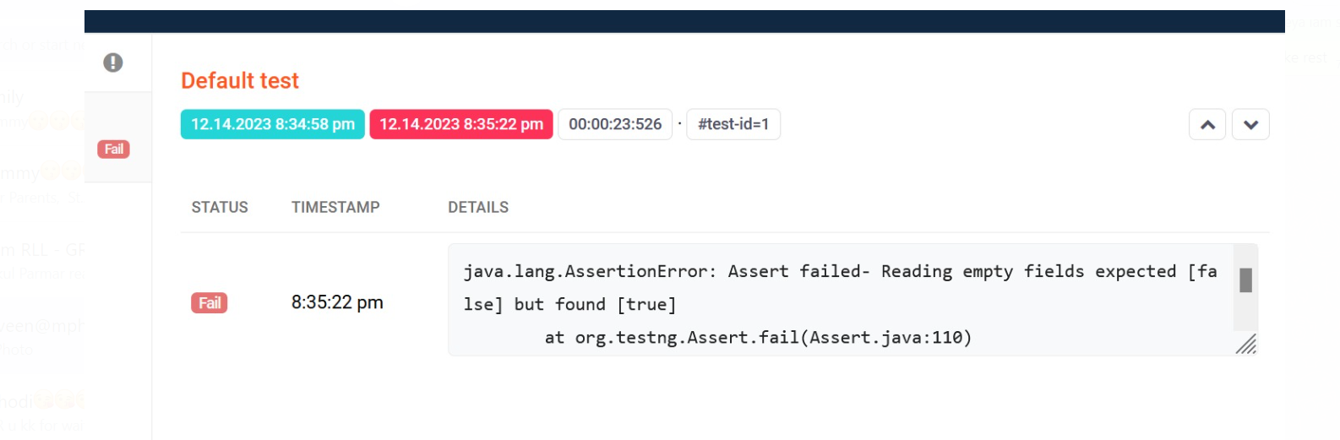
OUTPUT OF ASSERTION

Slide 29
DATA DRIVEN TESTING
Software testing can be a time-consuming slog. Using Data-Driven Testing(DDT), a revolutionary approach that leverages external data for efficient and effective testing. With DDT, you write less code, cover more scenarios, and maintaining tests are easy.
Automate’s tests using data from external sources(spreadsheets, databases, etc.)
This Execute’s a single test script with multiple data sets, maximizing coverage.

Slide 30
BENEFITS AND COMPONETS OF DDT
BENEFITS
COMPONENTS
Increased Test Coverage: Explore diverse scenarios effortlessly.
Reduced Maintenance: Modify data, not scripts, for easy updates.
Improved Data Management: Centralize and track test data.
Enhanced Reusability: Divide and components
Test Scripts: Define the logic and flow, independent of data
Data Sources: Store test data (input/expected output) in external files.
Data Parameters: Placeholders in the script filled with data from the source

Slide 31
IMPLEMENTATION AND TOOL OF DDT
Choosing a Data Source:
Spreadsheets (simple, familiar)
CSV files (structured, machine-readable)
Databases (scalable, secure)
APIs (dynamic, real-time)
Popular DDT Frameworks:
JUnit Parameterized (Java)
NUnit Parameterized (C#)
Robot Framework (multi-language)
Data Parameterization:
Annotations (@DataDriven)
Data Providers (supply data to tests)
Configuration Files (external data storage)

Slide 32
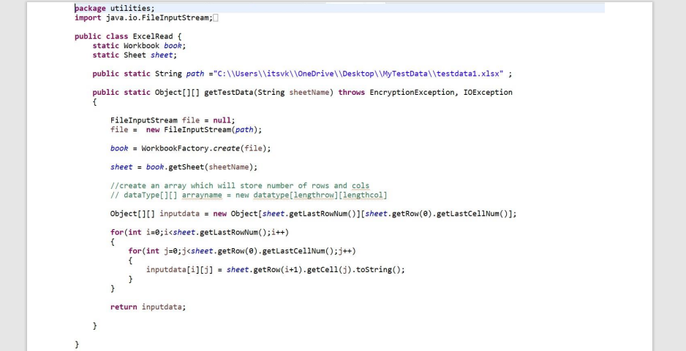
Code Snippet of DDT

Slide 33
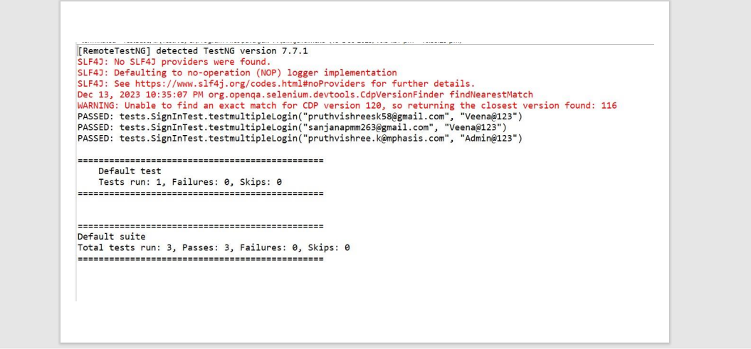
Output of DataDrivenTesting

Slide 34
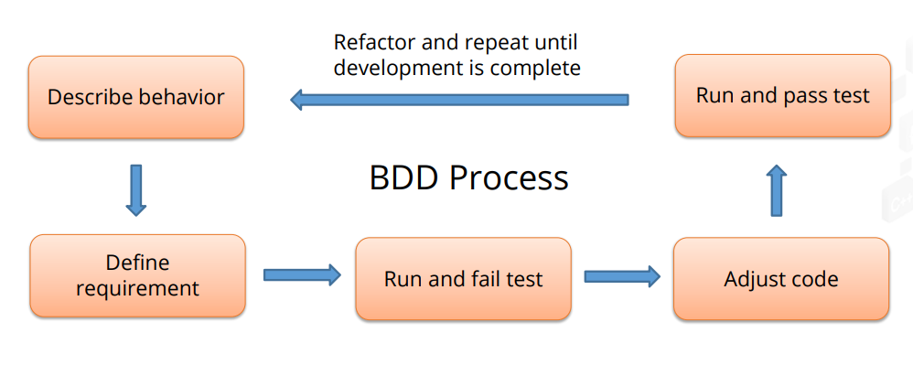
WHY CUCUMBER?
Designs and develops an application around a behavior preferred by users

Slide 35
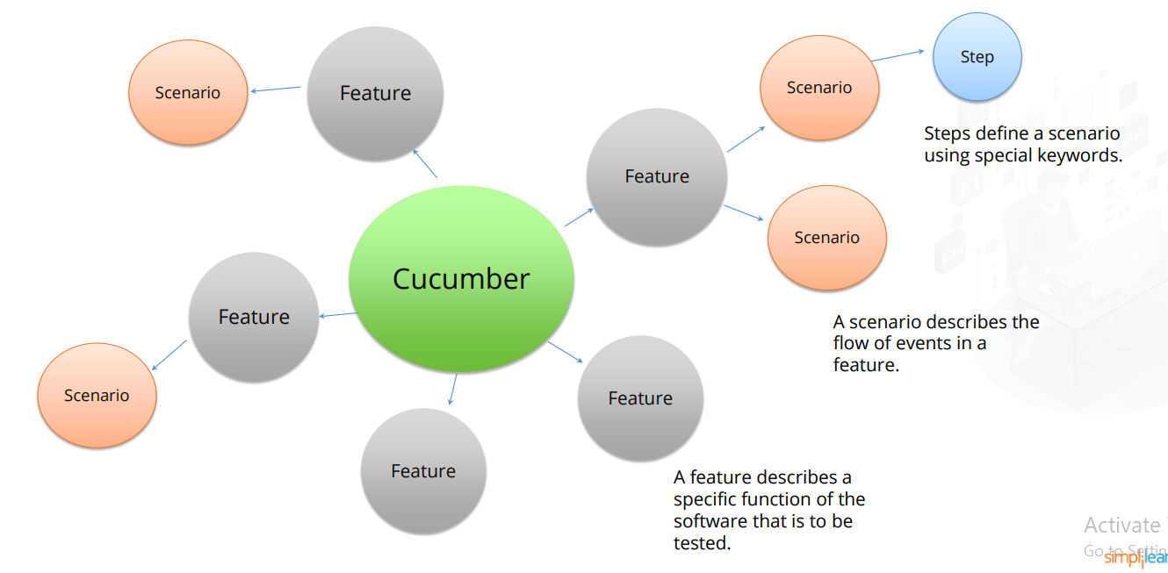
Cucumber is a software tool that is used to implement BDD

Slide 36
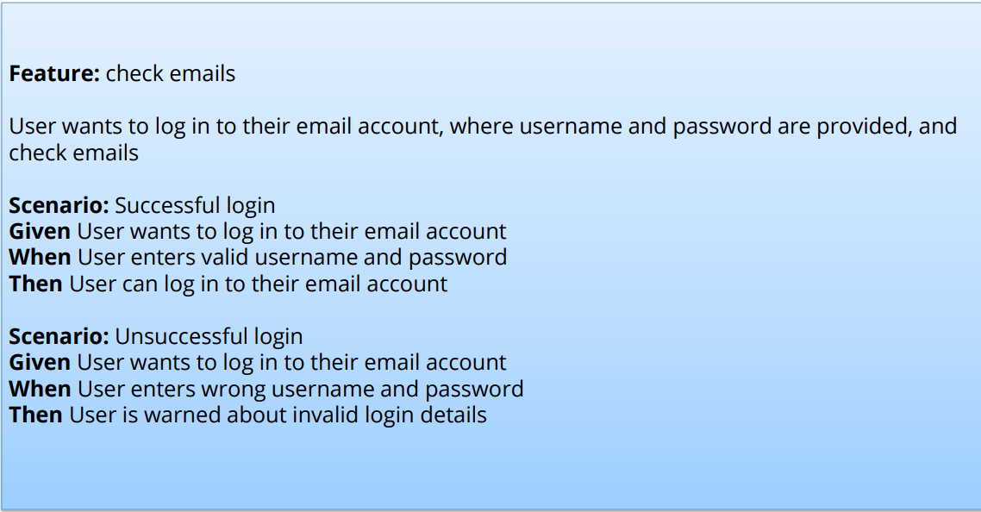

Slide 37
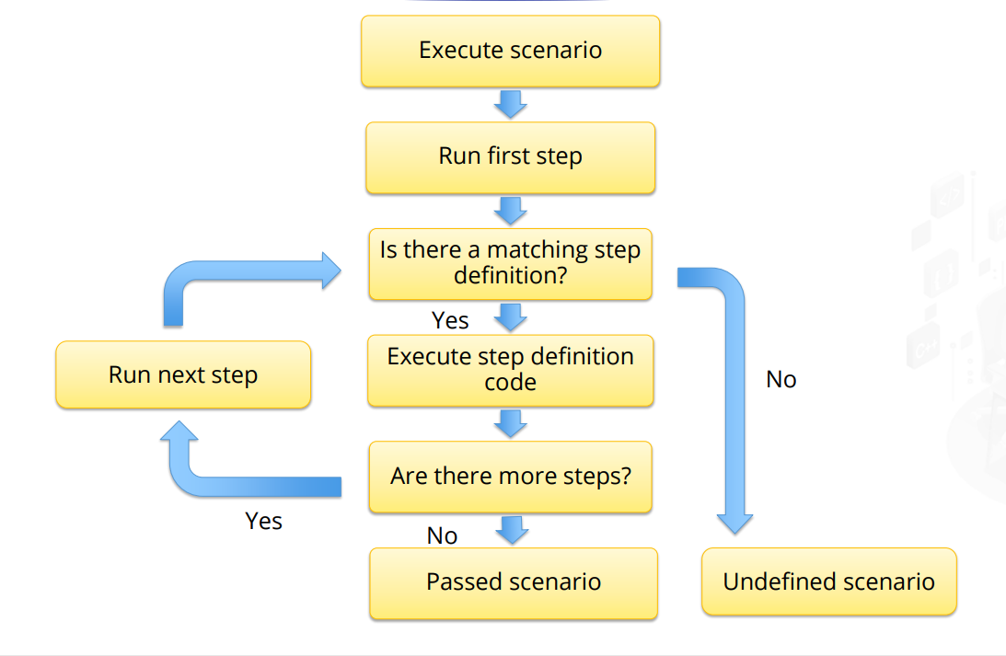
Step Definition
Step definition is an automation code that comes with a pattern or an annotation, which maps the code to test case steps.

Slide 38
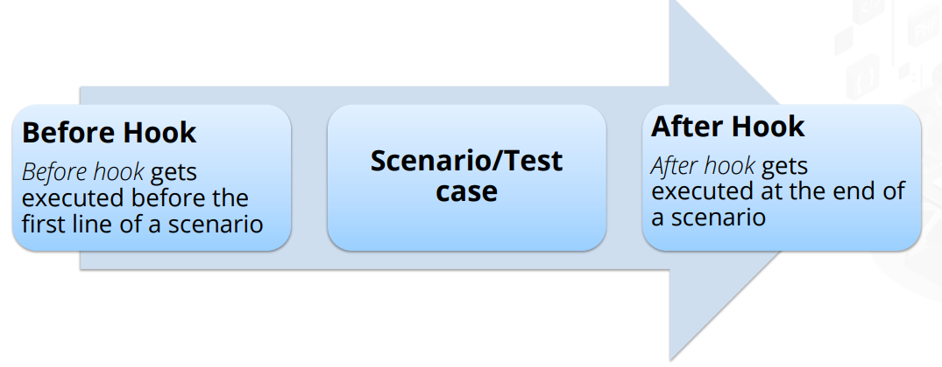
Hooks
Hooks are executable blocks of code that run before and after each scenario.
They manage code redundancy by allowing setup to be run prior to tests and teardown.

Slide 39
Scenario Keyword: Test Cases
Background Step
Step Argument
Scenario Outline
Comments
Tags

Slide 40
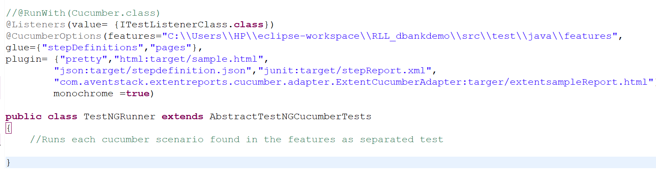
Cucumber Options
features
glue
plugin
dryRun
monochrome
tags

Slide 41
LOG
Log412 It allow for easy configuration of advanced logging best practices such as rolling files, different type of logging output destinations, Support for structured logging formats such as JSON,XML using multiple loggers and filters and custom log level.
Firstly we have to add these two dependencies to log4j2 the API and log for Zip code.
Create resources a new source folder /src/main.
Create a properties file with the rate (log4j2. properties) should be only this name.

Slide 42
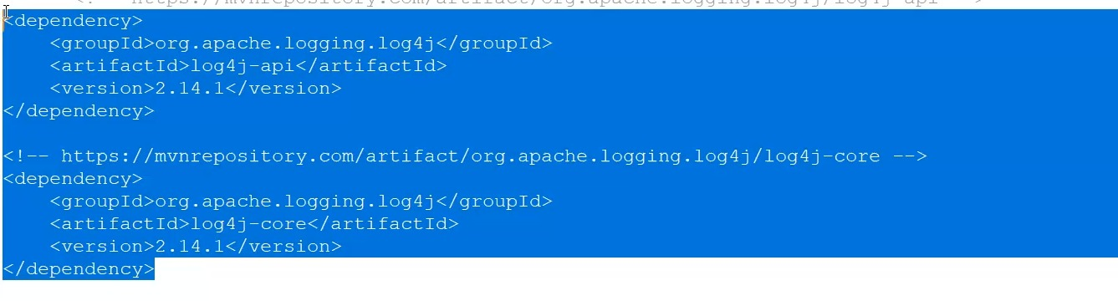
Dependencies of LOG

Slide 43
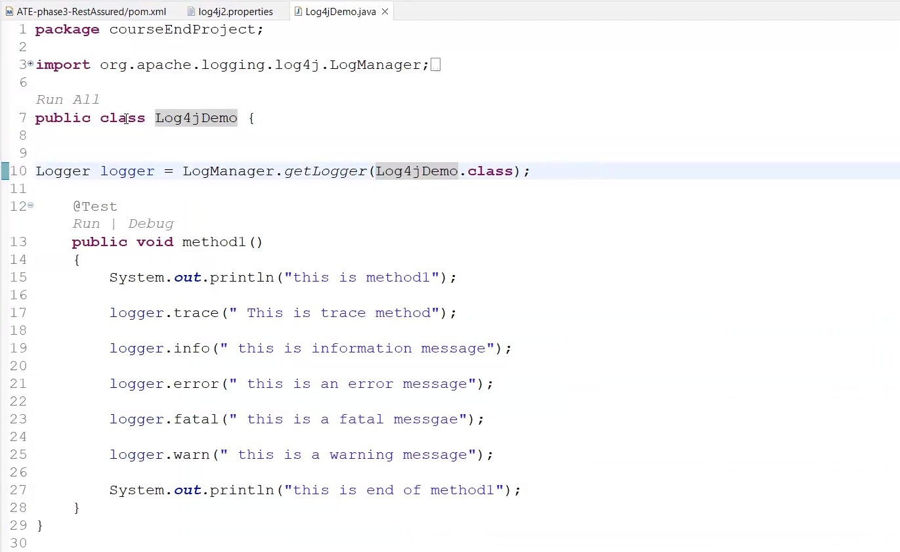
Code Snippet of LOG

Slide 44
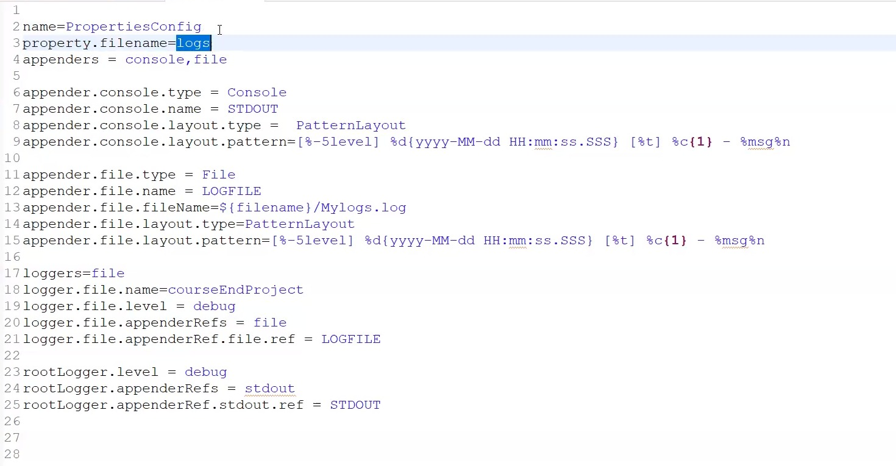

Slide 45
EXTENT REPORT
Extent Report provide a systematic way of collecting and presenting test execution results in an interactive and visually appealing HTML format.
It helps testers and stakeholders quickly understand the outcome of test executions, including details of passed and failed steps, screenshots, and system information.

Slide 46
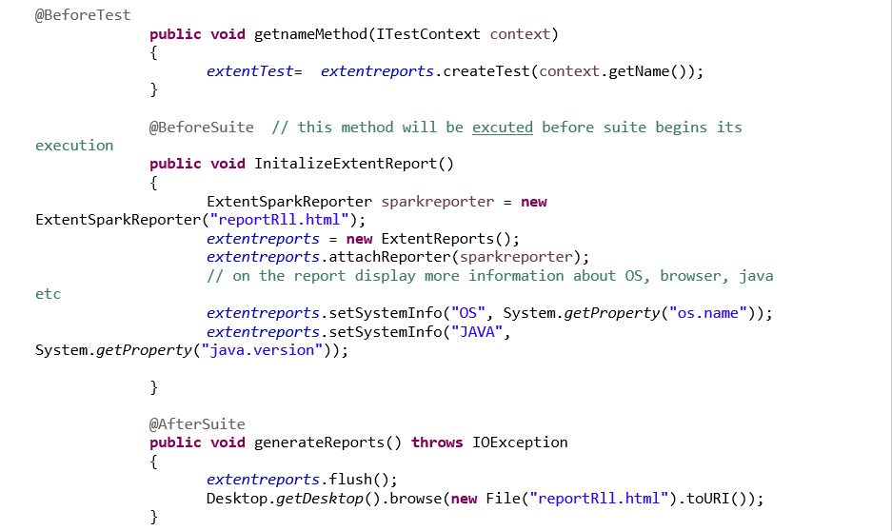
Code Snippet of EXTENT REPORT

Slide 47
WHY WE USE JIRA
Jira is used in Bugs, Issue and Change Request Tracking.
Jira can be used in Helpdesk, Support and Customer Services to create tickets and track the resolution and status of the created tickets.
Jira is very useful in workflow and process management

Slide 48
HOW JIRA USED IN THE PROJECT
EFFORTLESS TASK MANAGEMENT WITH JIRA :
It effortless creation, assign and manage tasks in Jira . Ensuring smooth execution and increases countability.
TRACK PROGRESS WITH JIRA DASHBOARD :
Explore JIRA’s dynamic dashboards and advanced reporting tool and tracking process.
SEAMLESS COLLABORATION IN JIRA :
Discover how JIRA facilitates seamless collaboration and communication across teams.

Slide 49
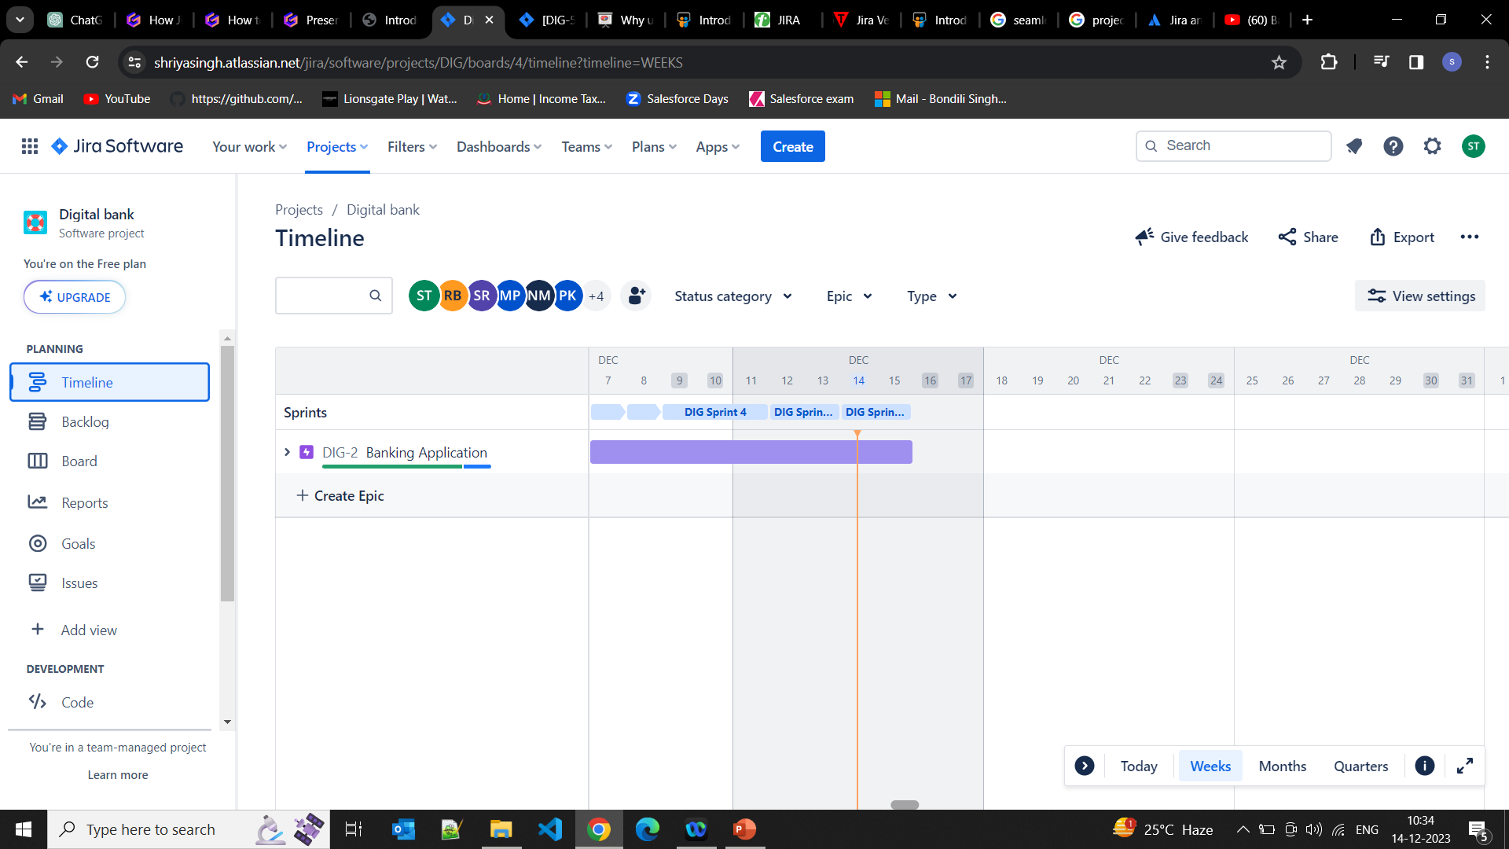
TIMELINE AND EPIC SCREENSHOT

Slide 50
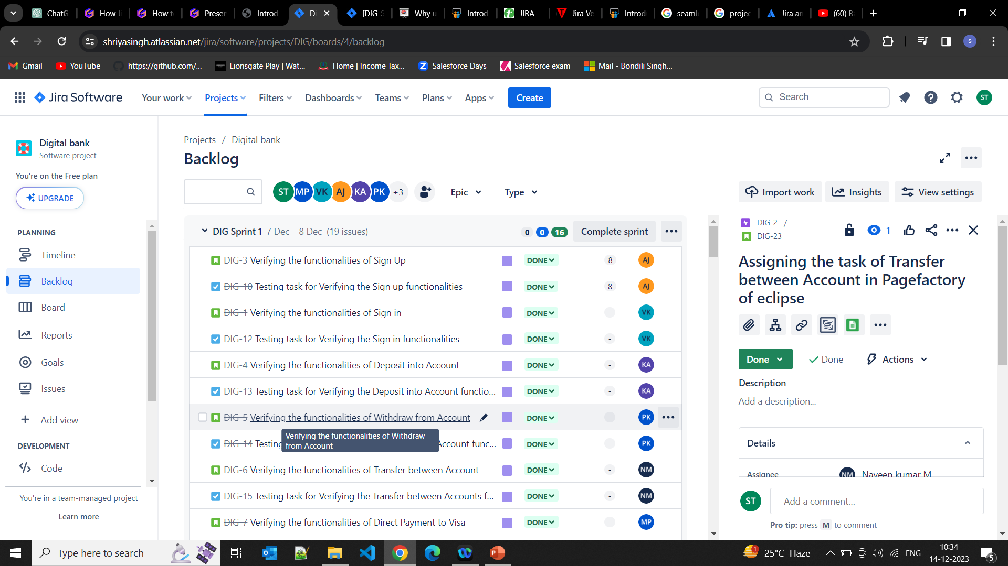
BACKLOG SCREENSHOT

Slide 51
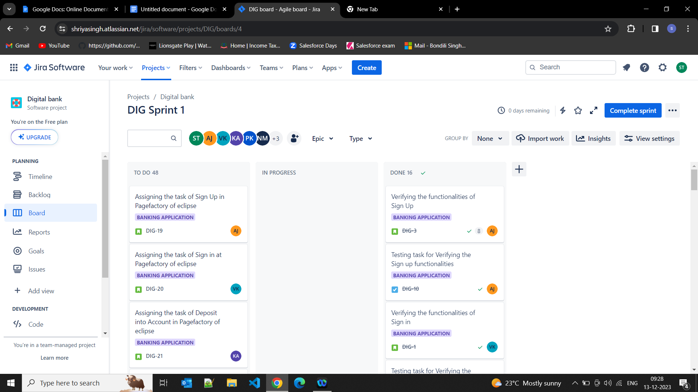
BOARD SCREENSHOT

Slide 52
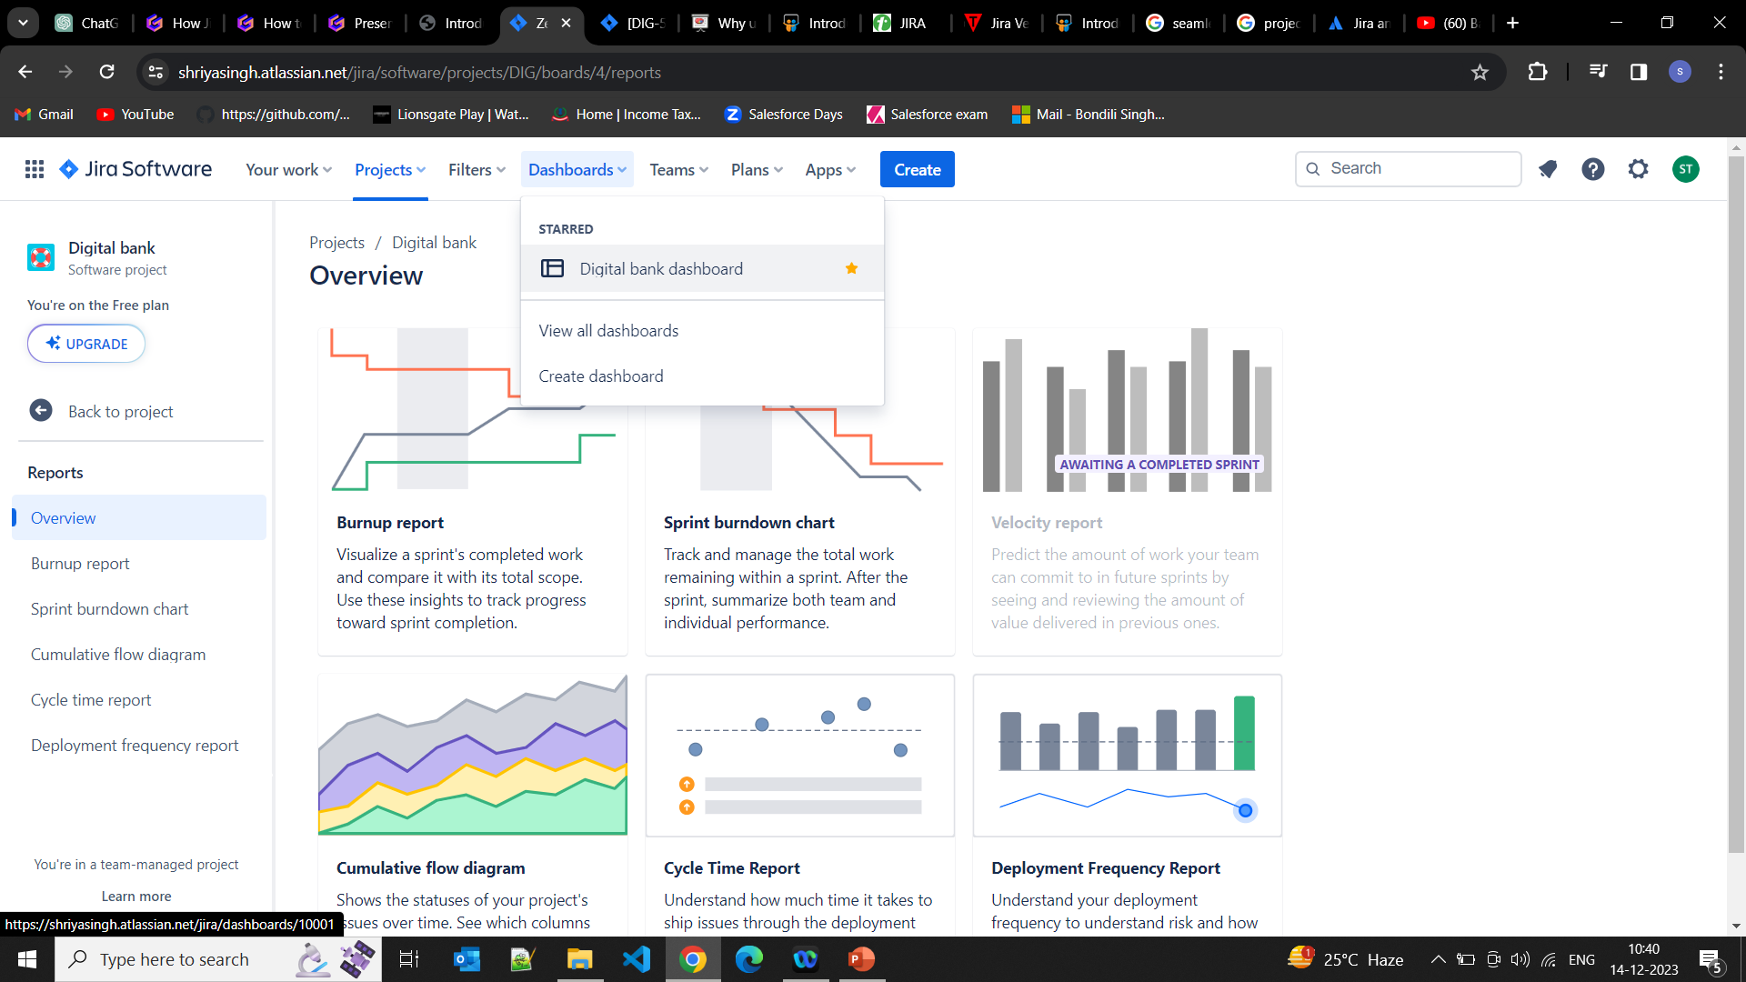
DASHBOARD SCREENSHOT

Slide 53
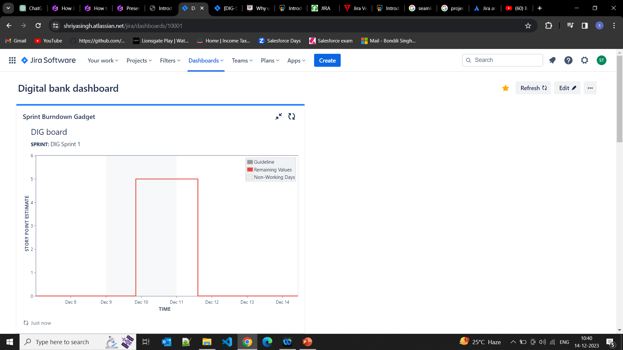
DASHBOARD SCREENSHOT

Slide 54
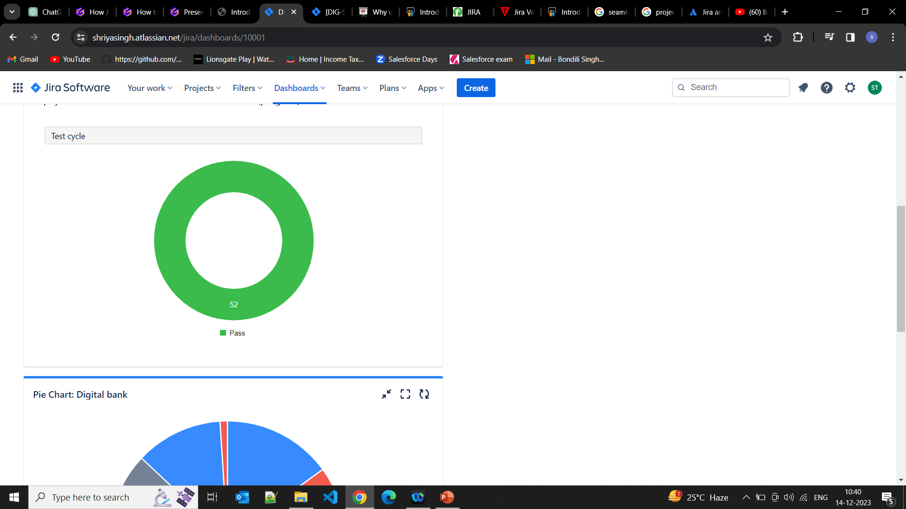
DASHBOARD SCREENSHOT

Slide 55
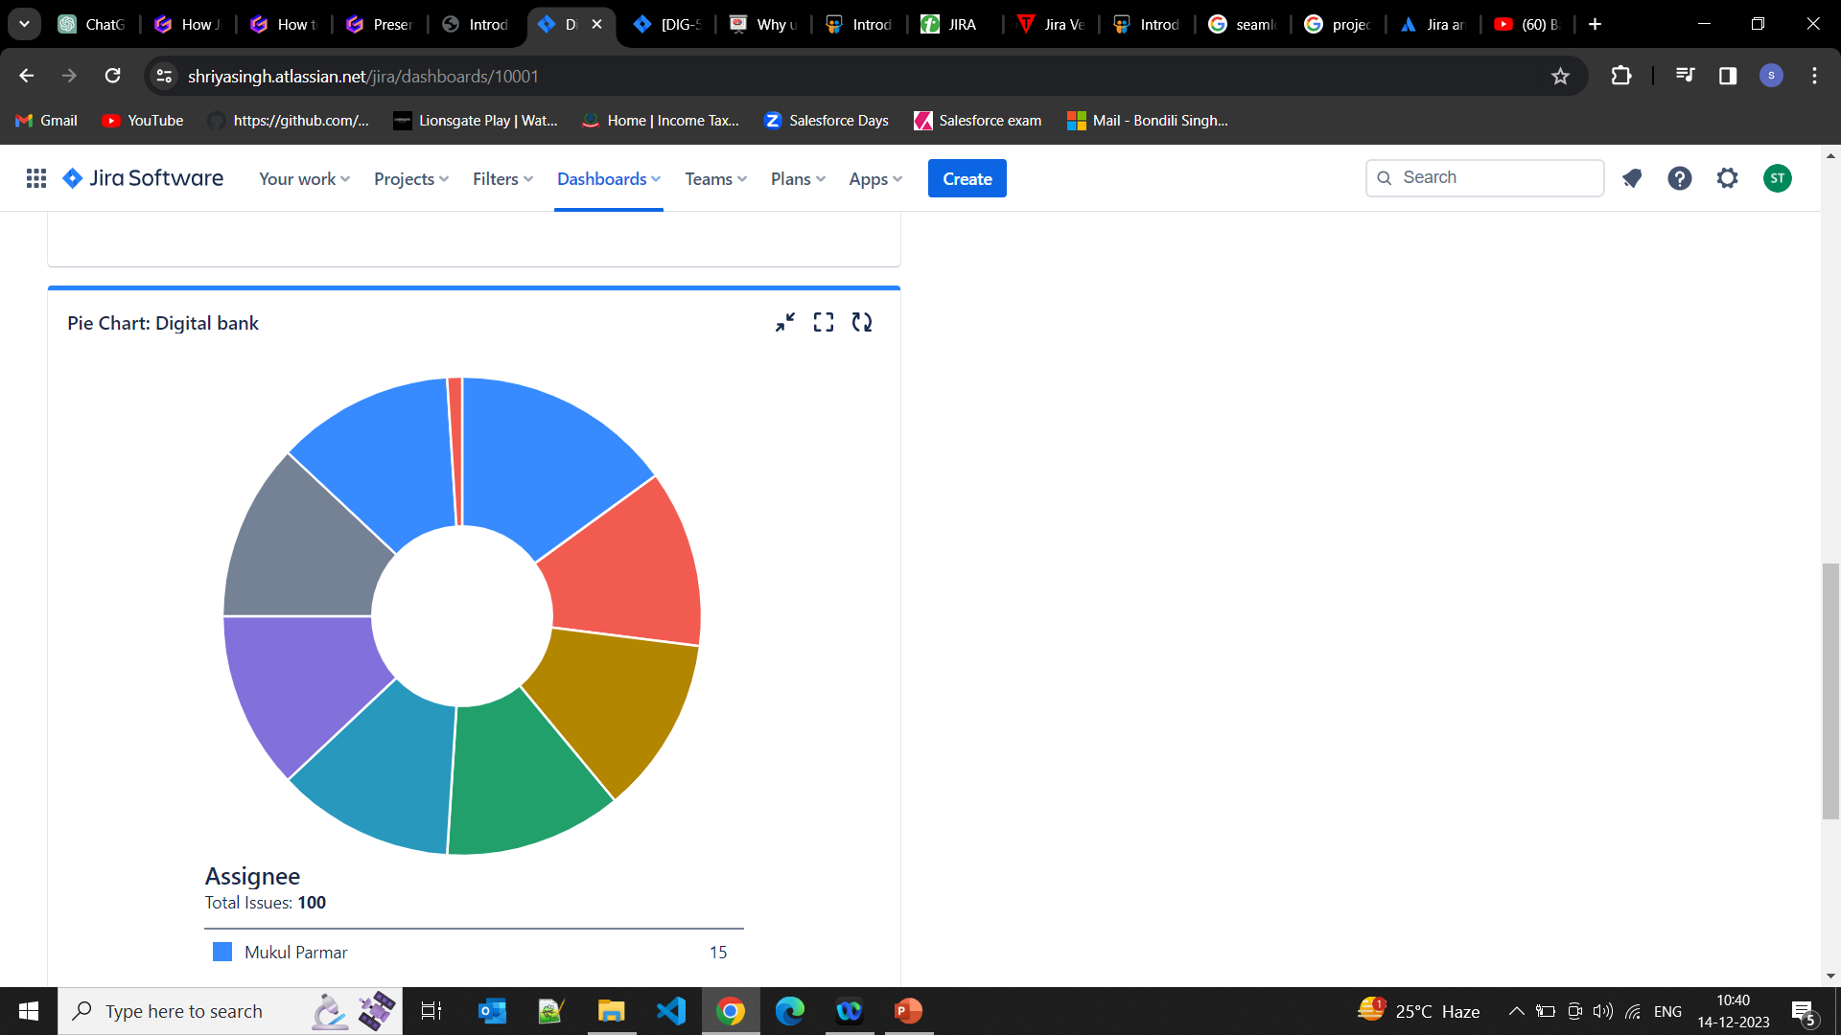
DASHBOARD SCREENSHOT

Slide 56
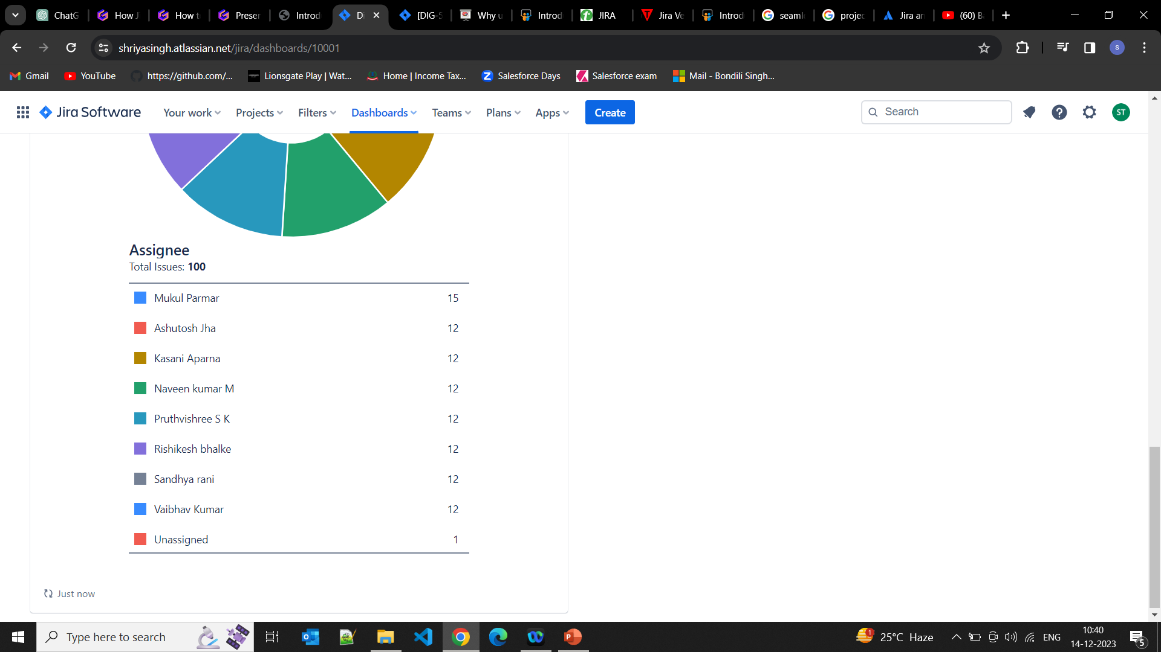
DASHBOARD SCREENSHOT

Slide 57
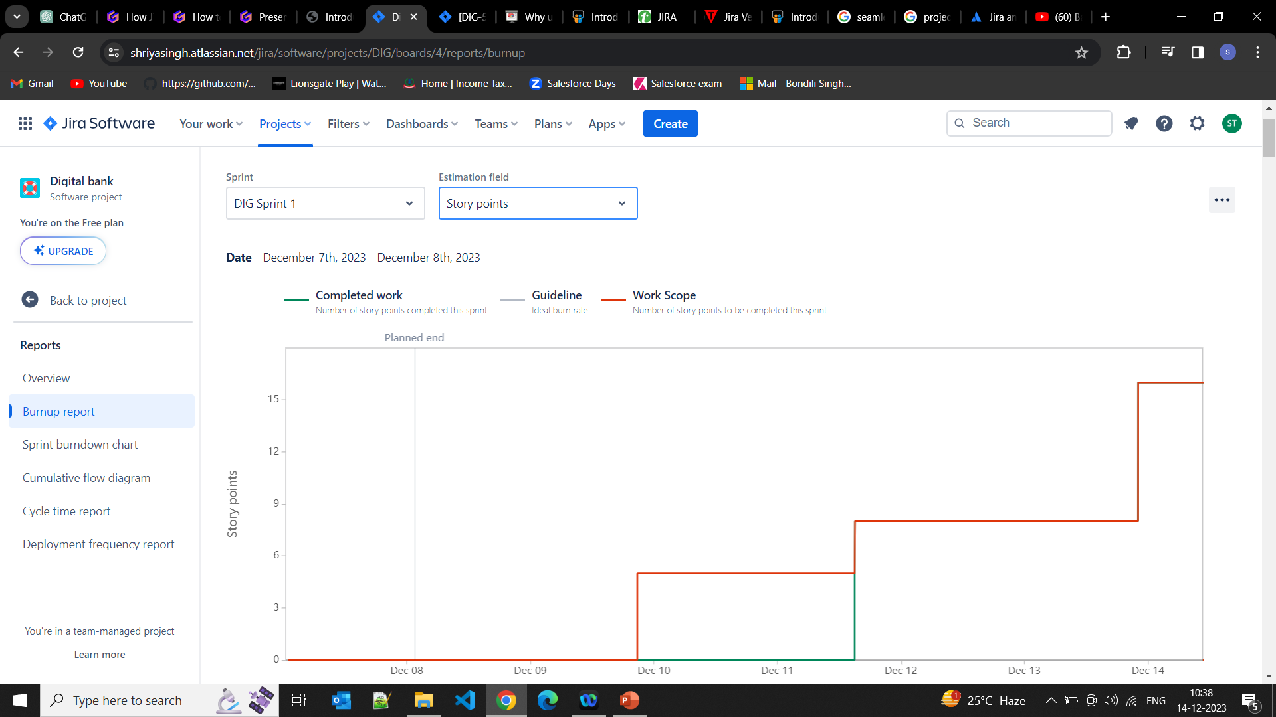
BURNUP REPORT

Slide 58
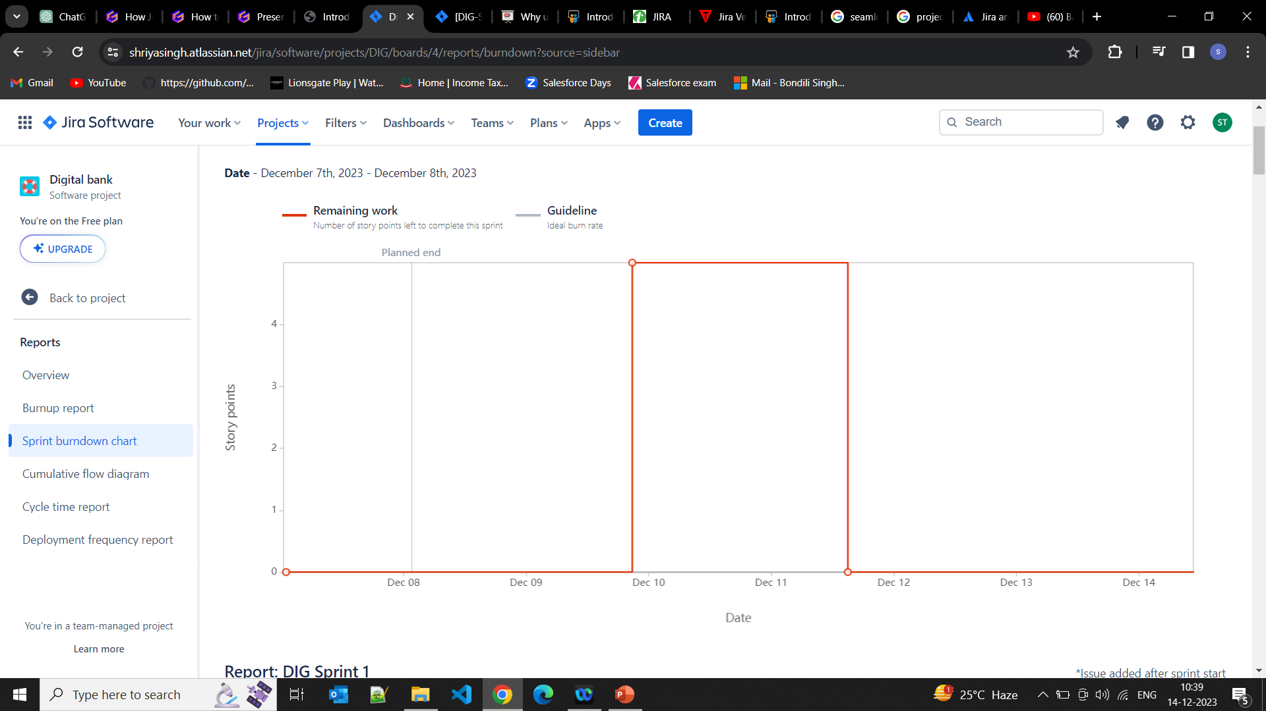
SPRINT BURNDOWN CHART

Slide 59
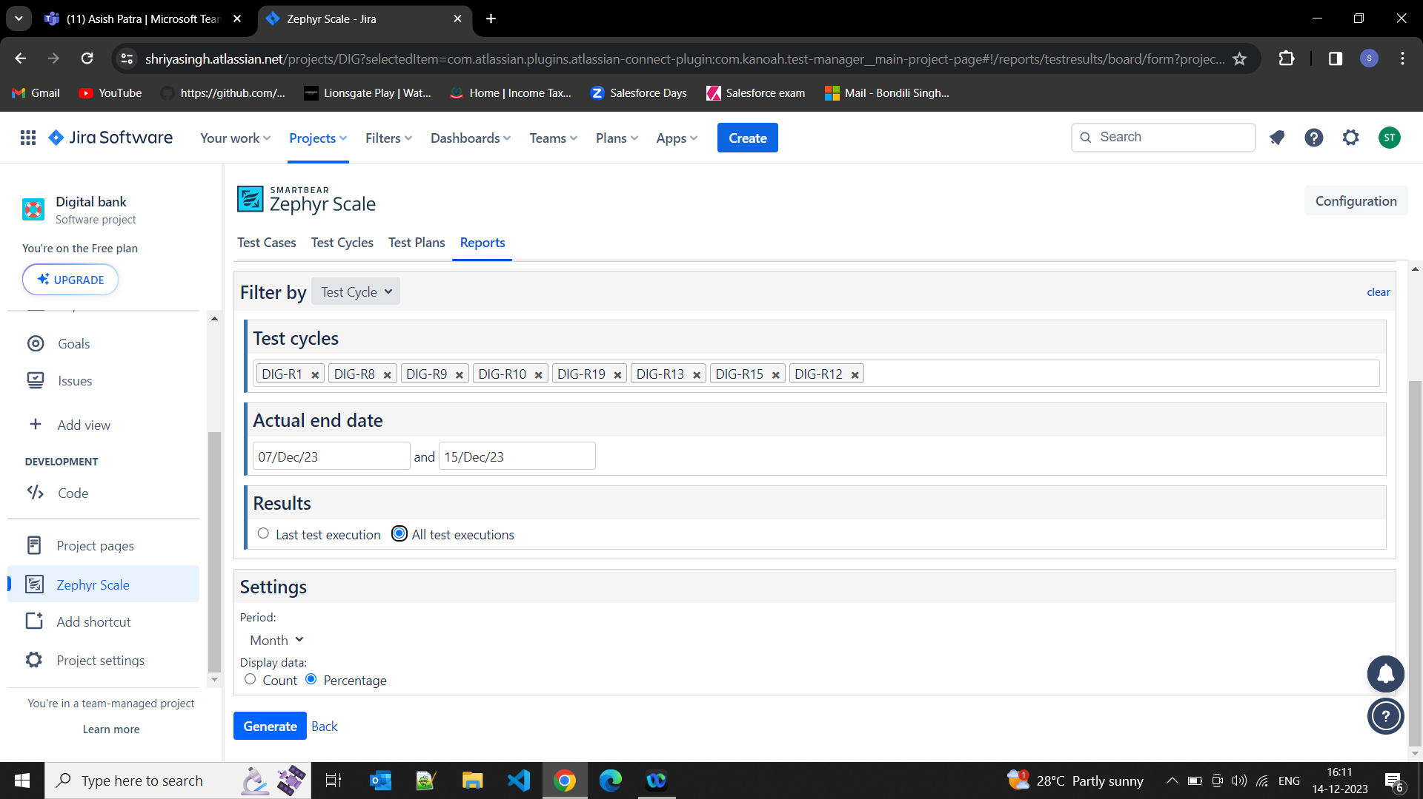
REPORTS

Slide 60
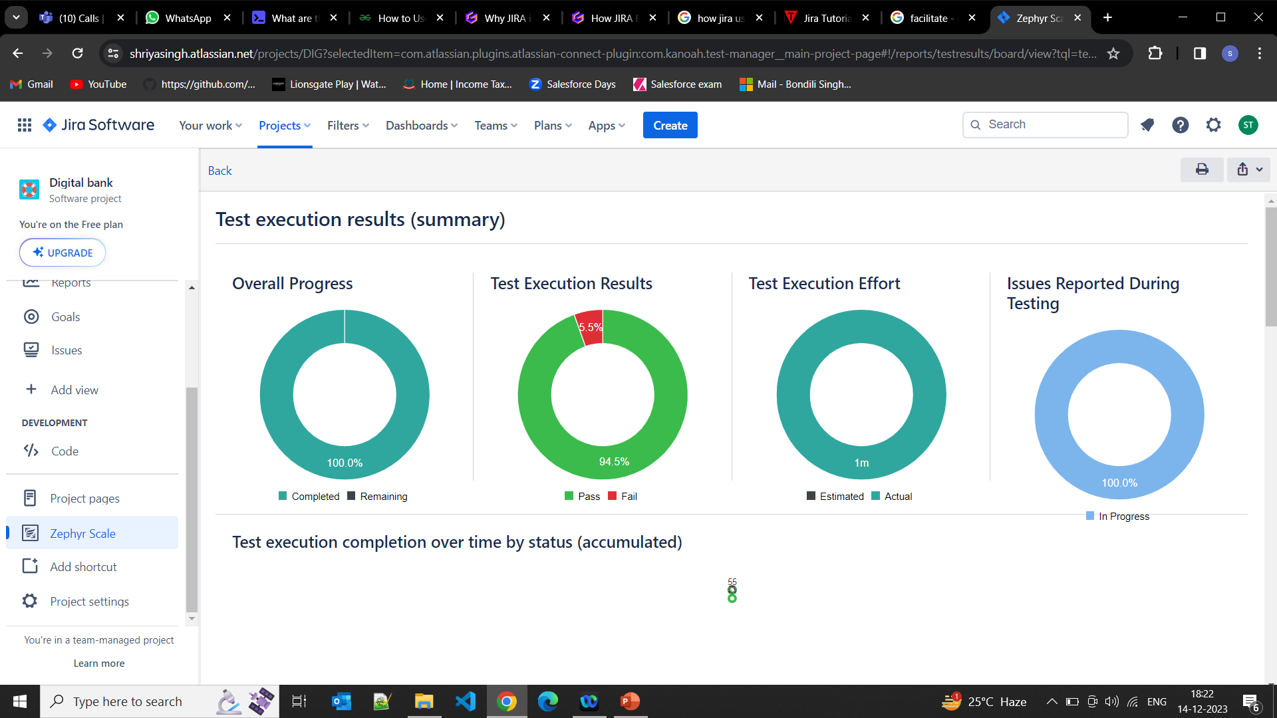
REPORTS

Slide 61
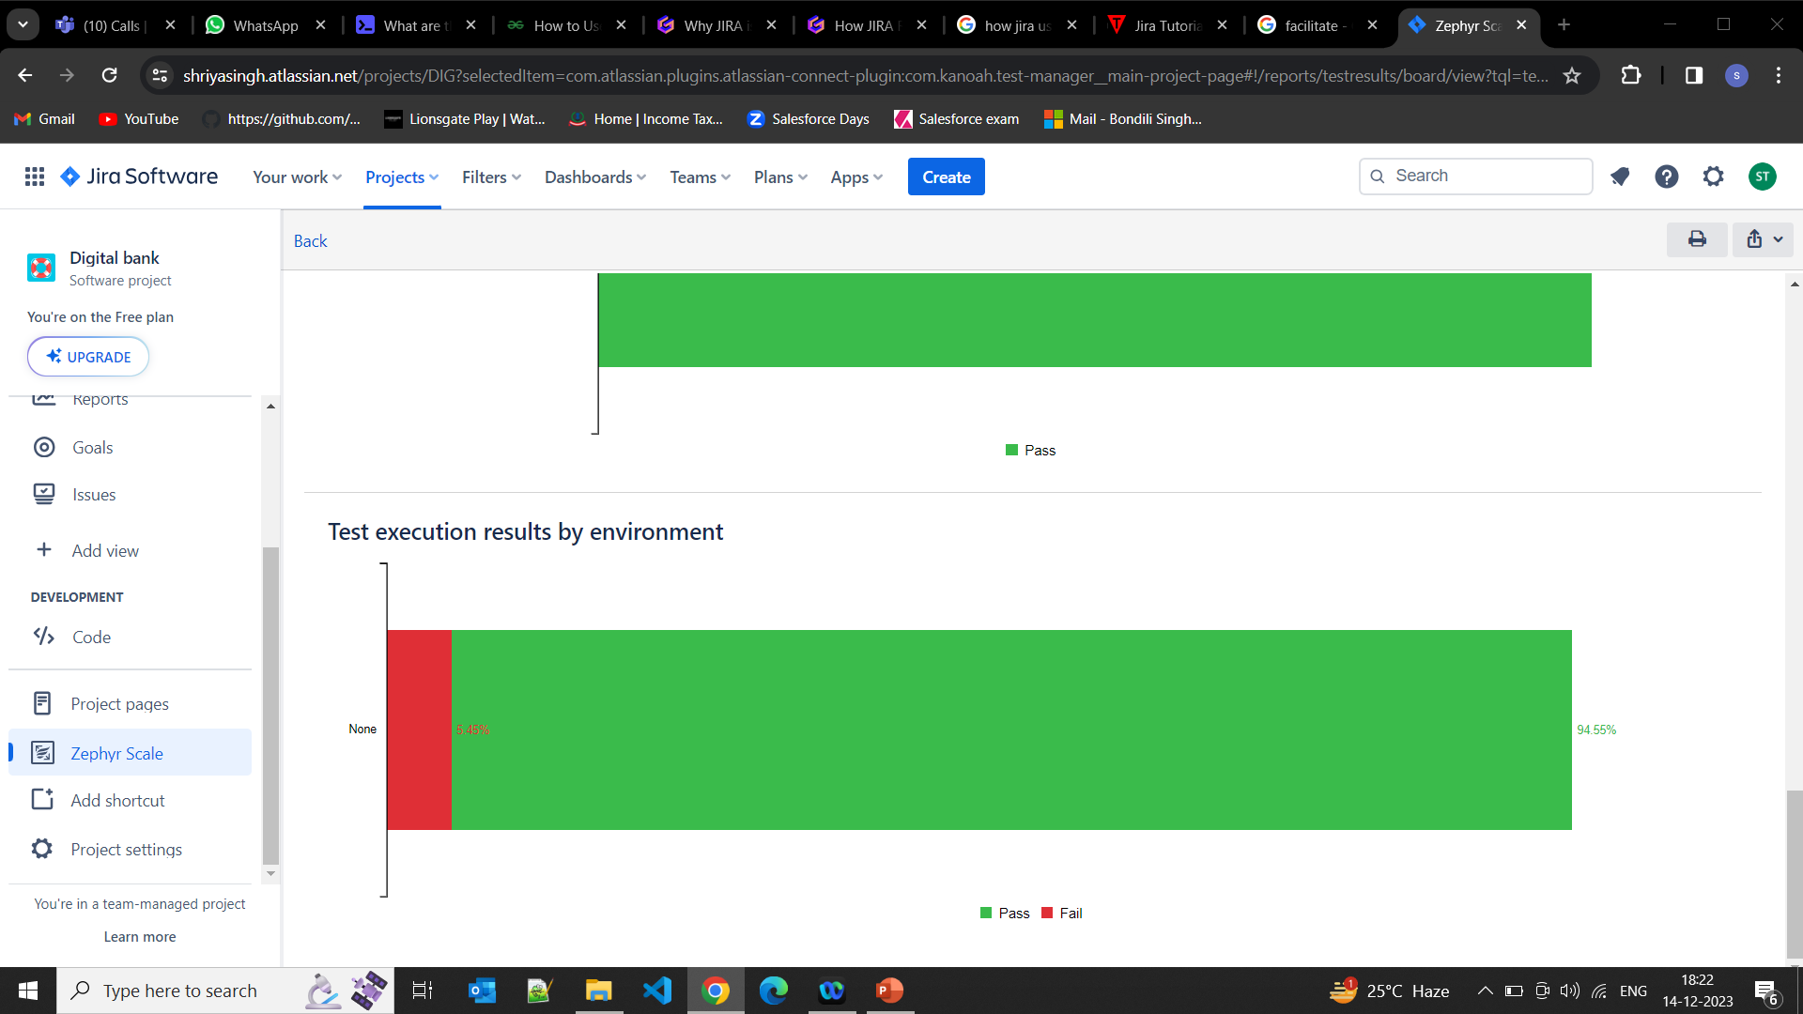
REPORTS

Slide 62
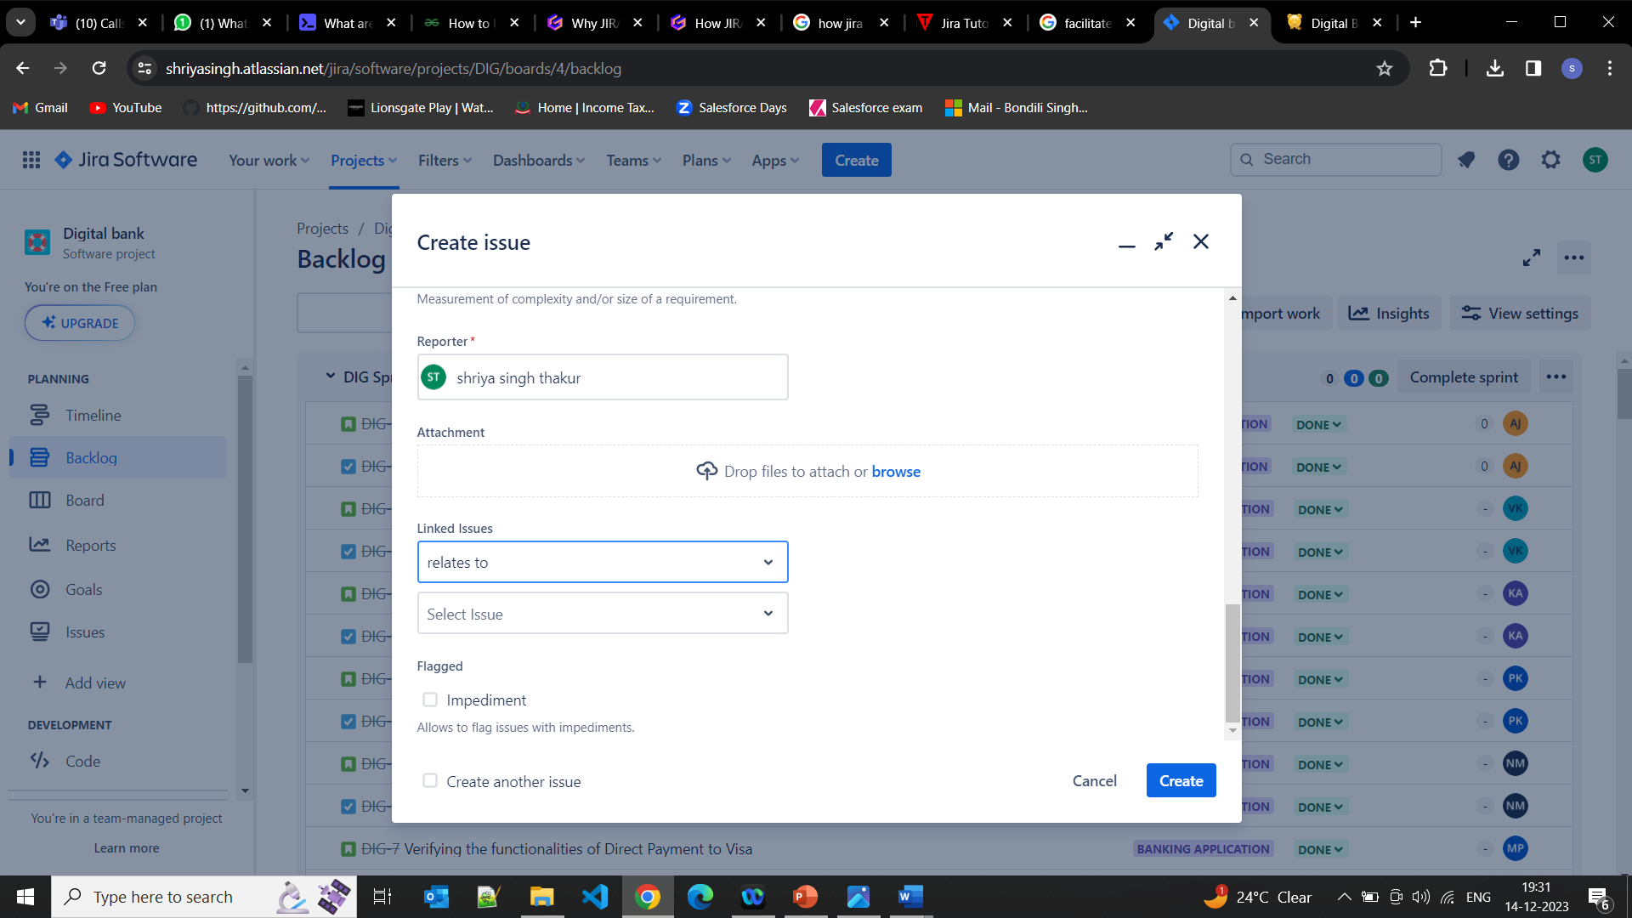
SCREENSHOTS

Slide 63
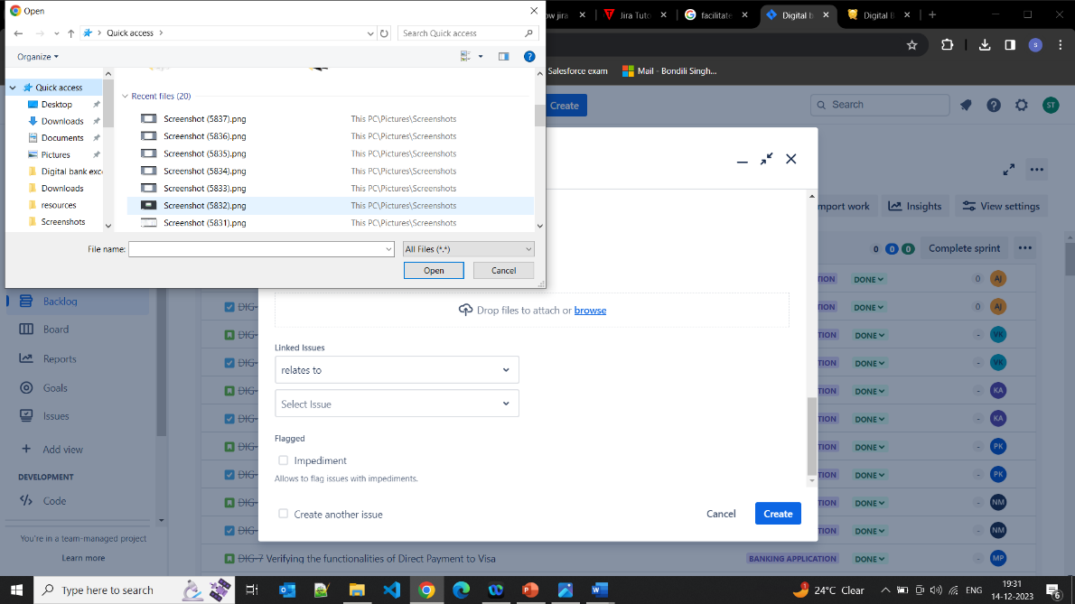
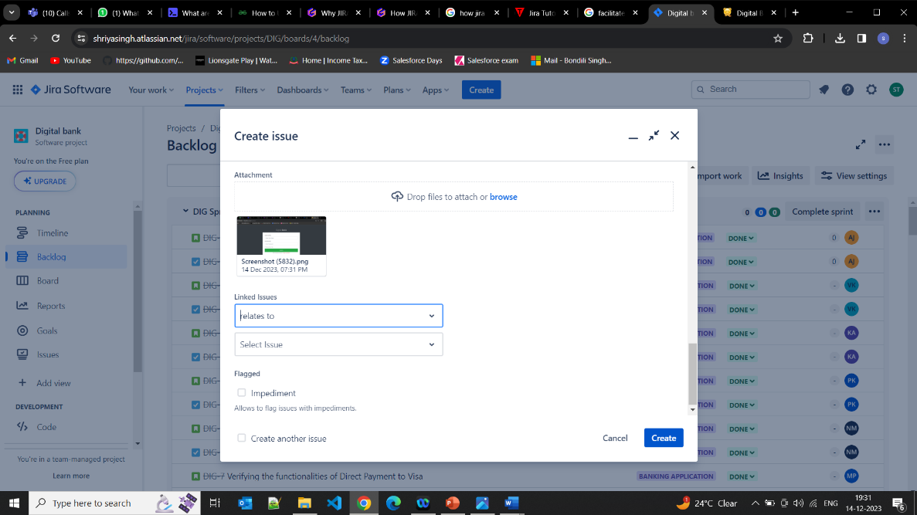
SCREENSHOTS

Slide 64
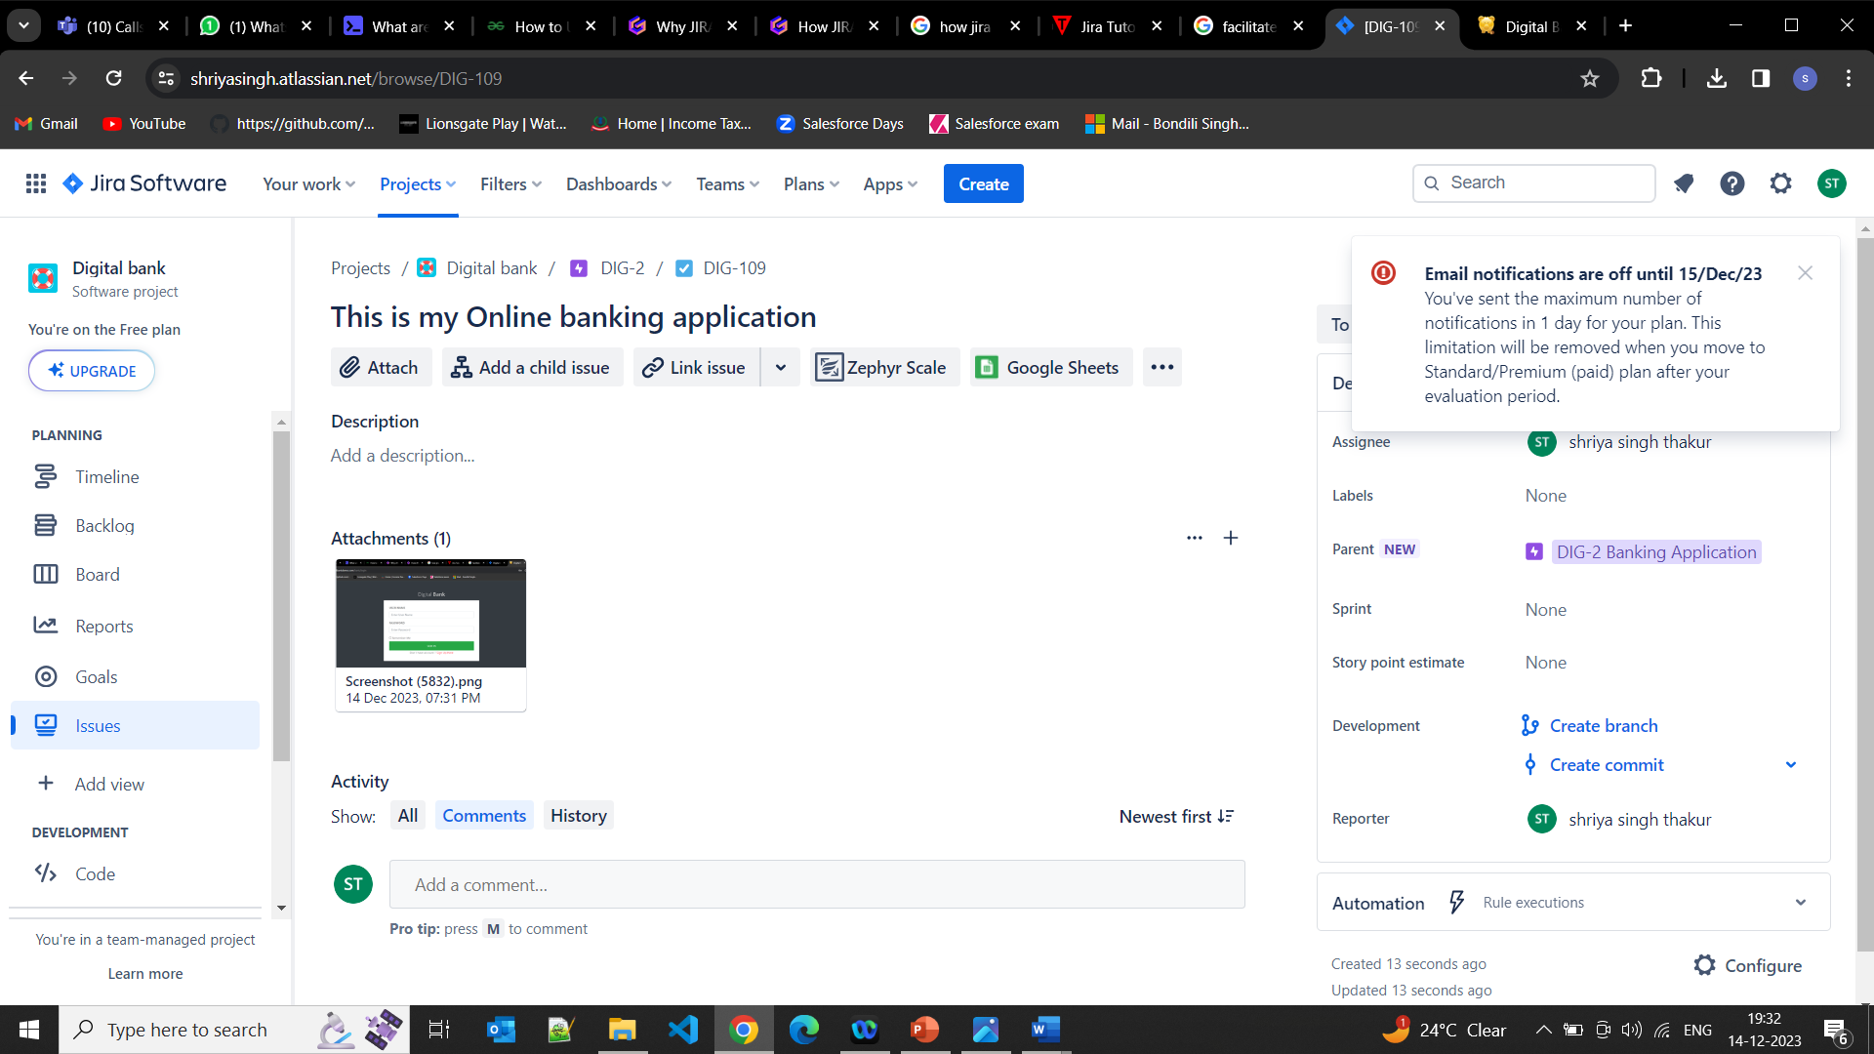
SCREENSHOTS

Slide 65

THANK YOU ~ Group II

